Slide 1
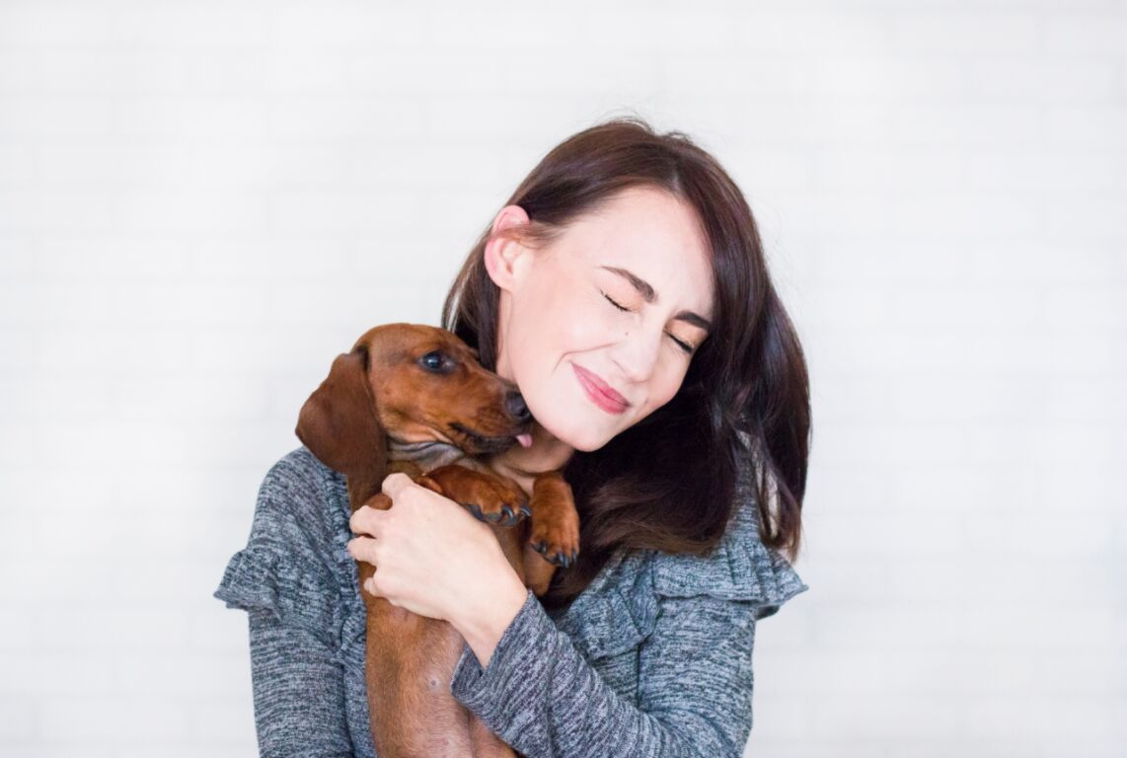
project pupdate.
PRESENTED BY: RACHEL FRNKA, ASHLEY KUTTLER, RYAN CLARK, UMAIR KHAKOO, & ALEX BRACHO

Slide 2
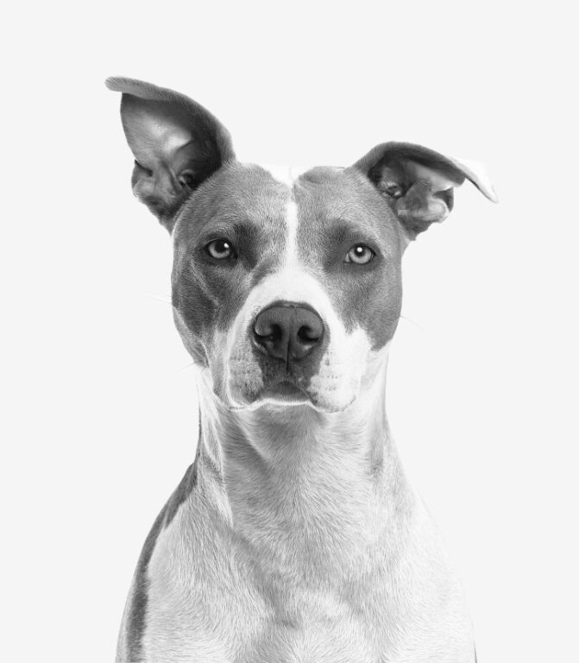

Seven in ten (71%) dog parents say their pup has made them happier people.
-BARKBOX DOG PARENT STUDY

Slide 3
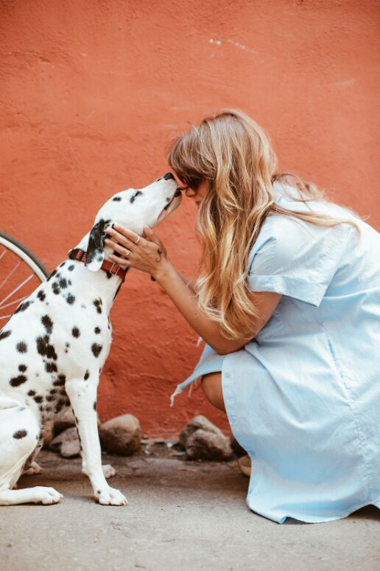

scope:
AN INTERACTIVE WEBSITE TO ALLOW USERS TO DISCOVER THEIR PERFECT FUTURE FURRY FRIEND

Slide 4
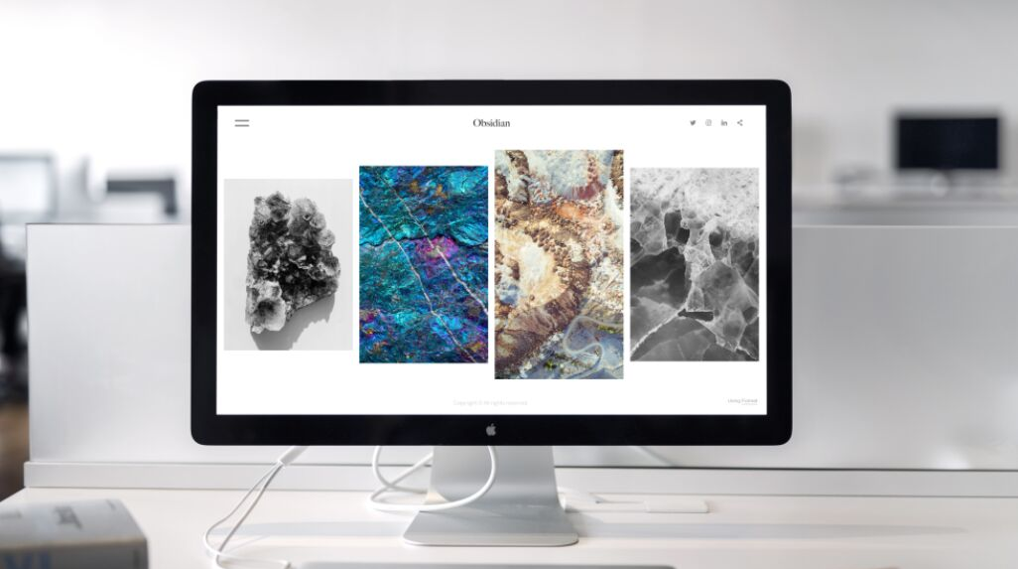
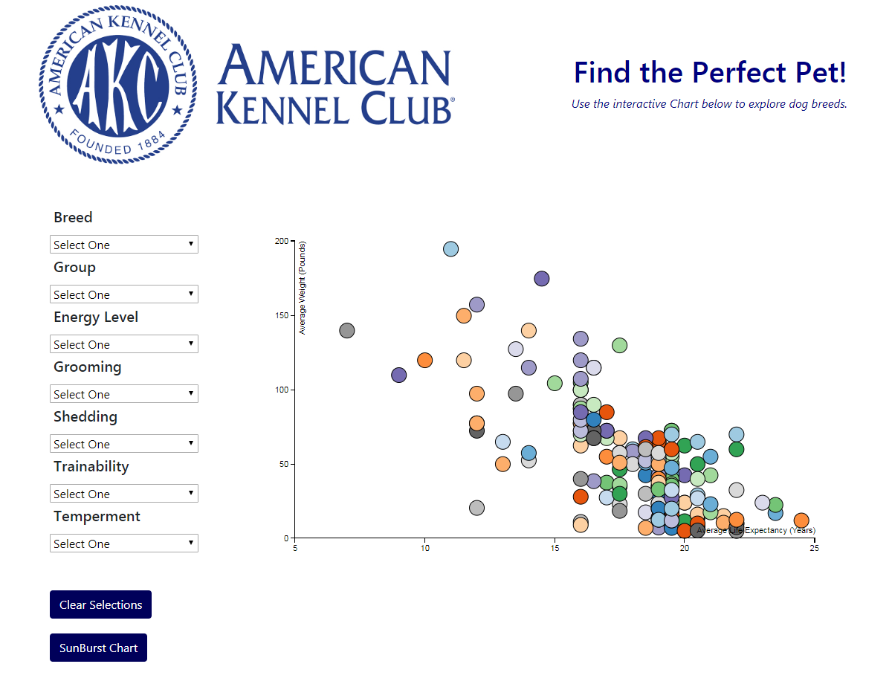
BACK END
WEB SCRAPING
DATA CLEANING
DATA STORAGE
FRONT END
THE SCATTER PLOT
THE SUNBURST
outline

Slide 5
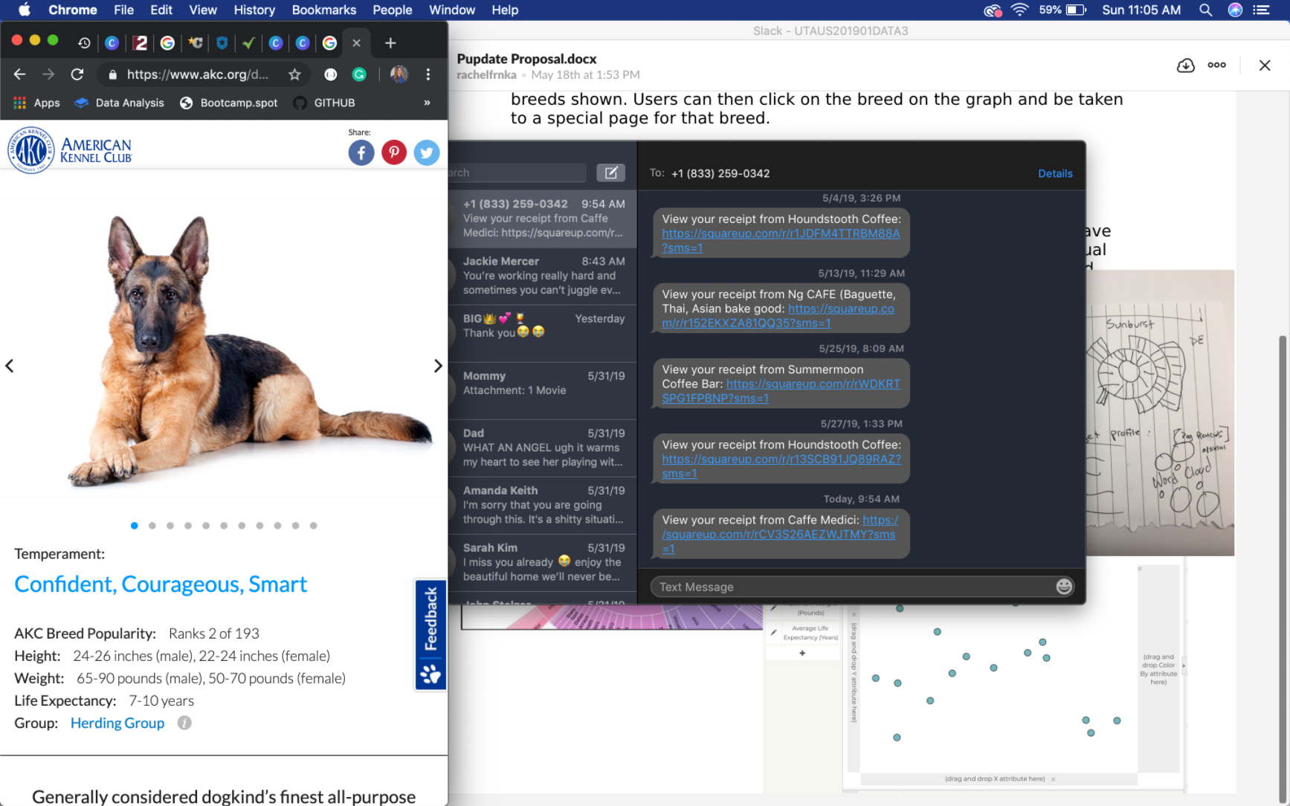
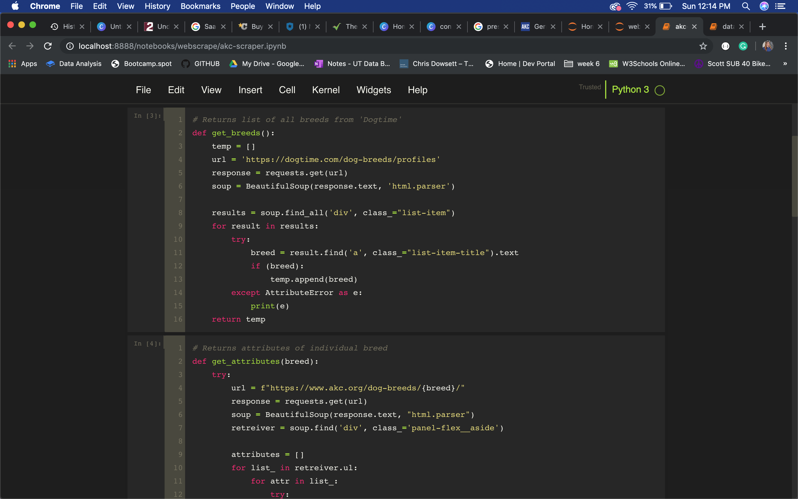
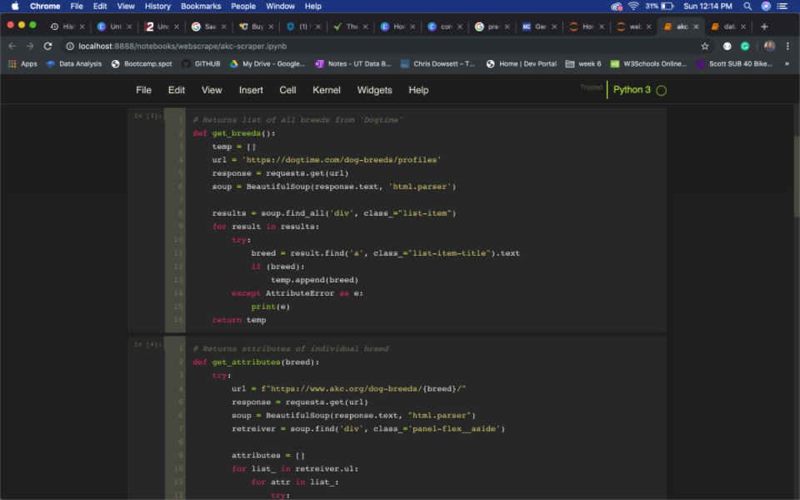
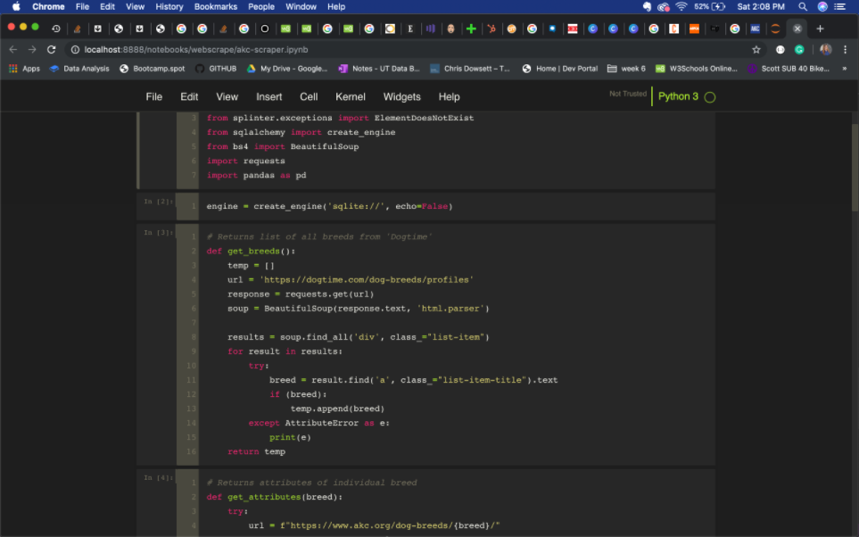
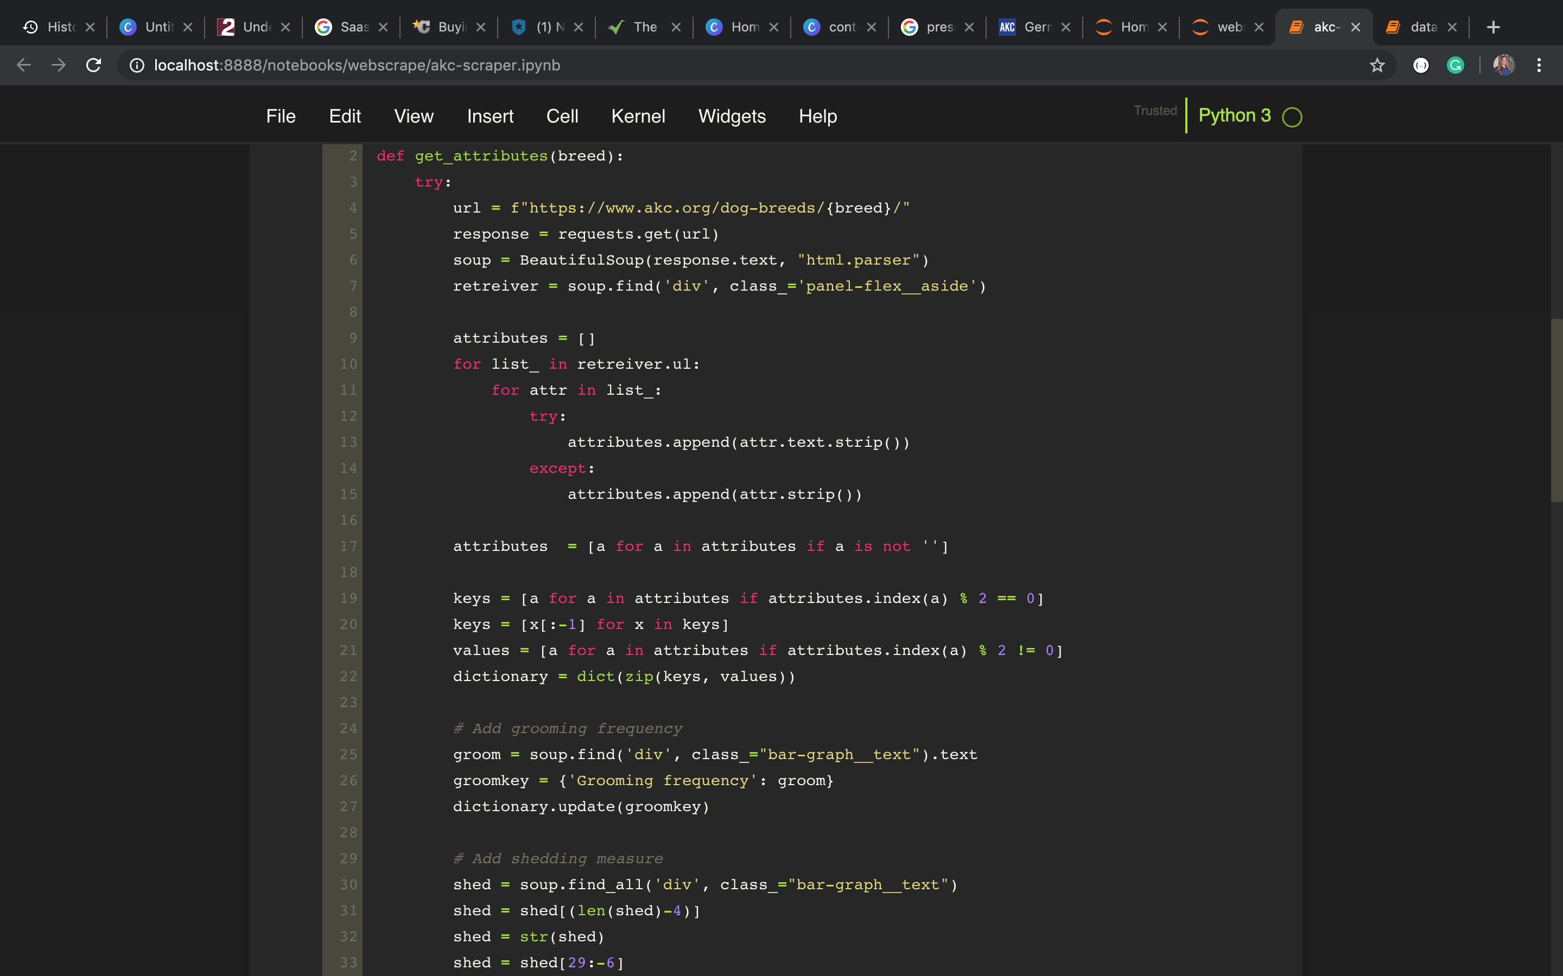
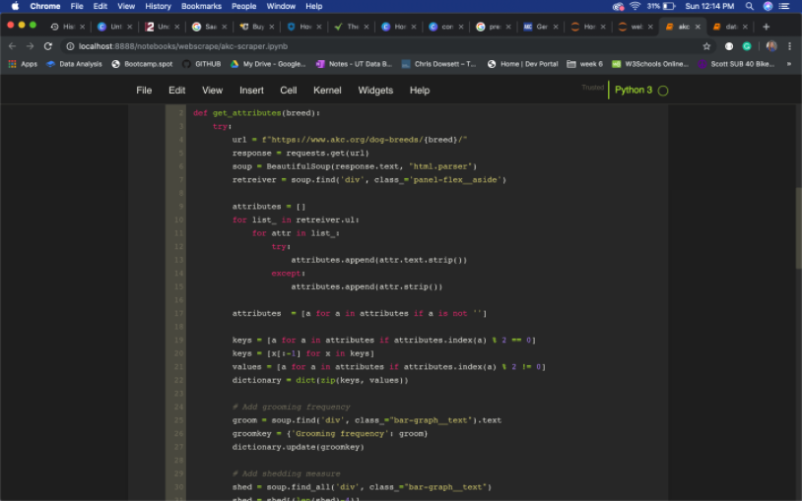
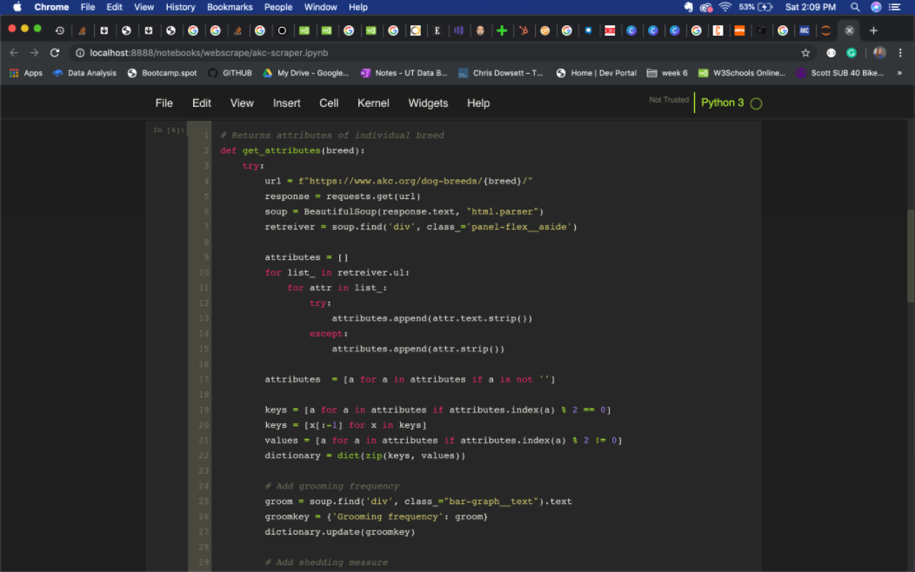
web scraping
COLLECT ALL
BREEDS
COLLECT ALL
BREED INFO

Slide 6
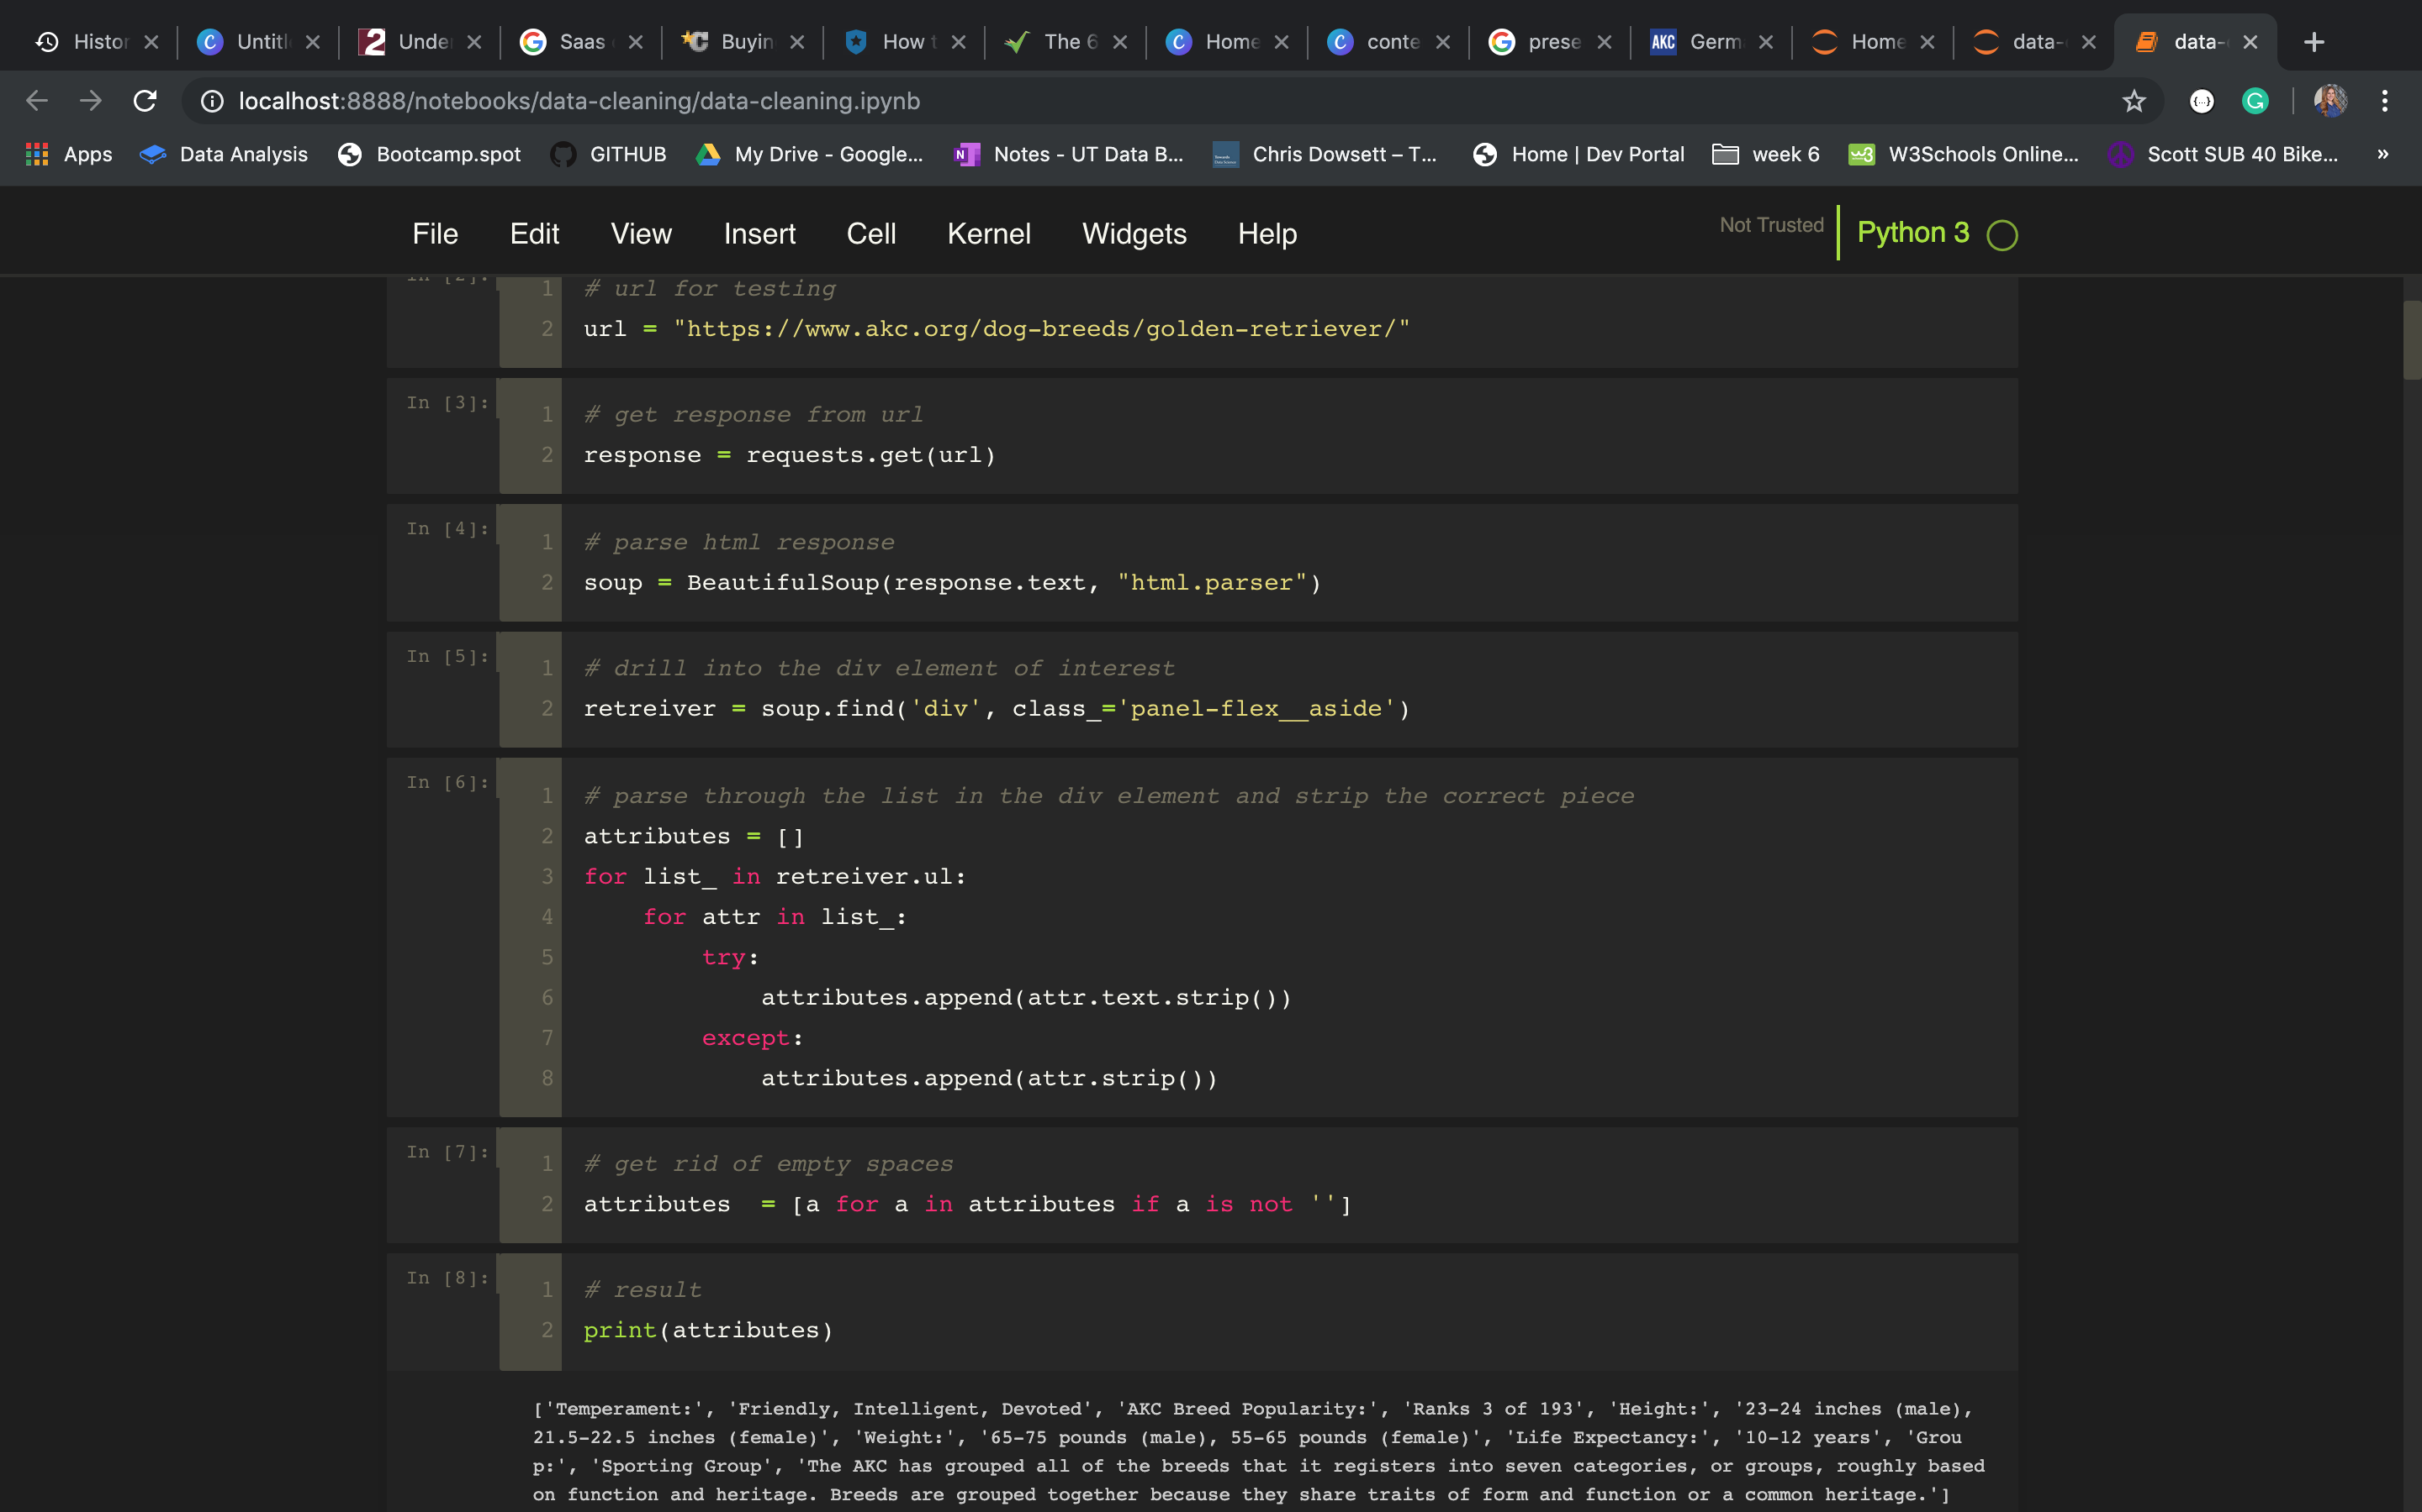
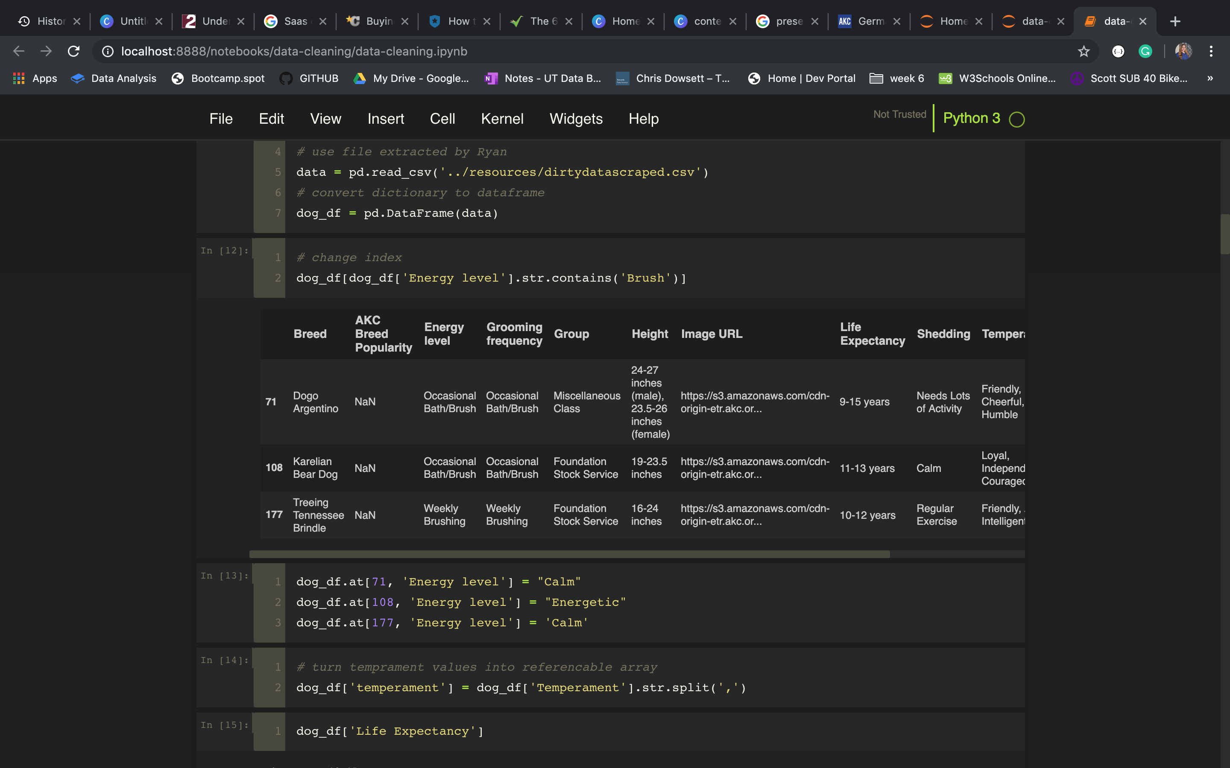
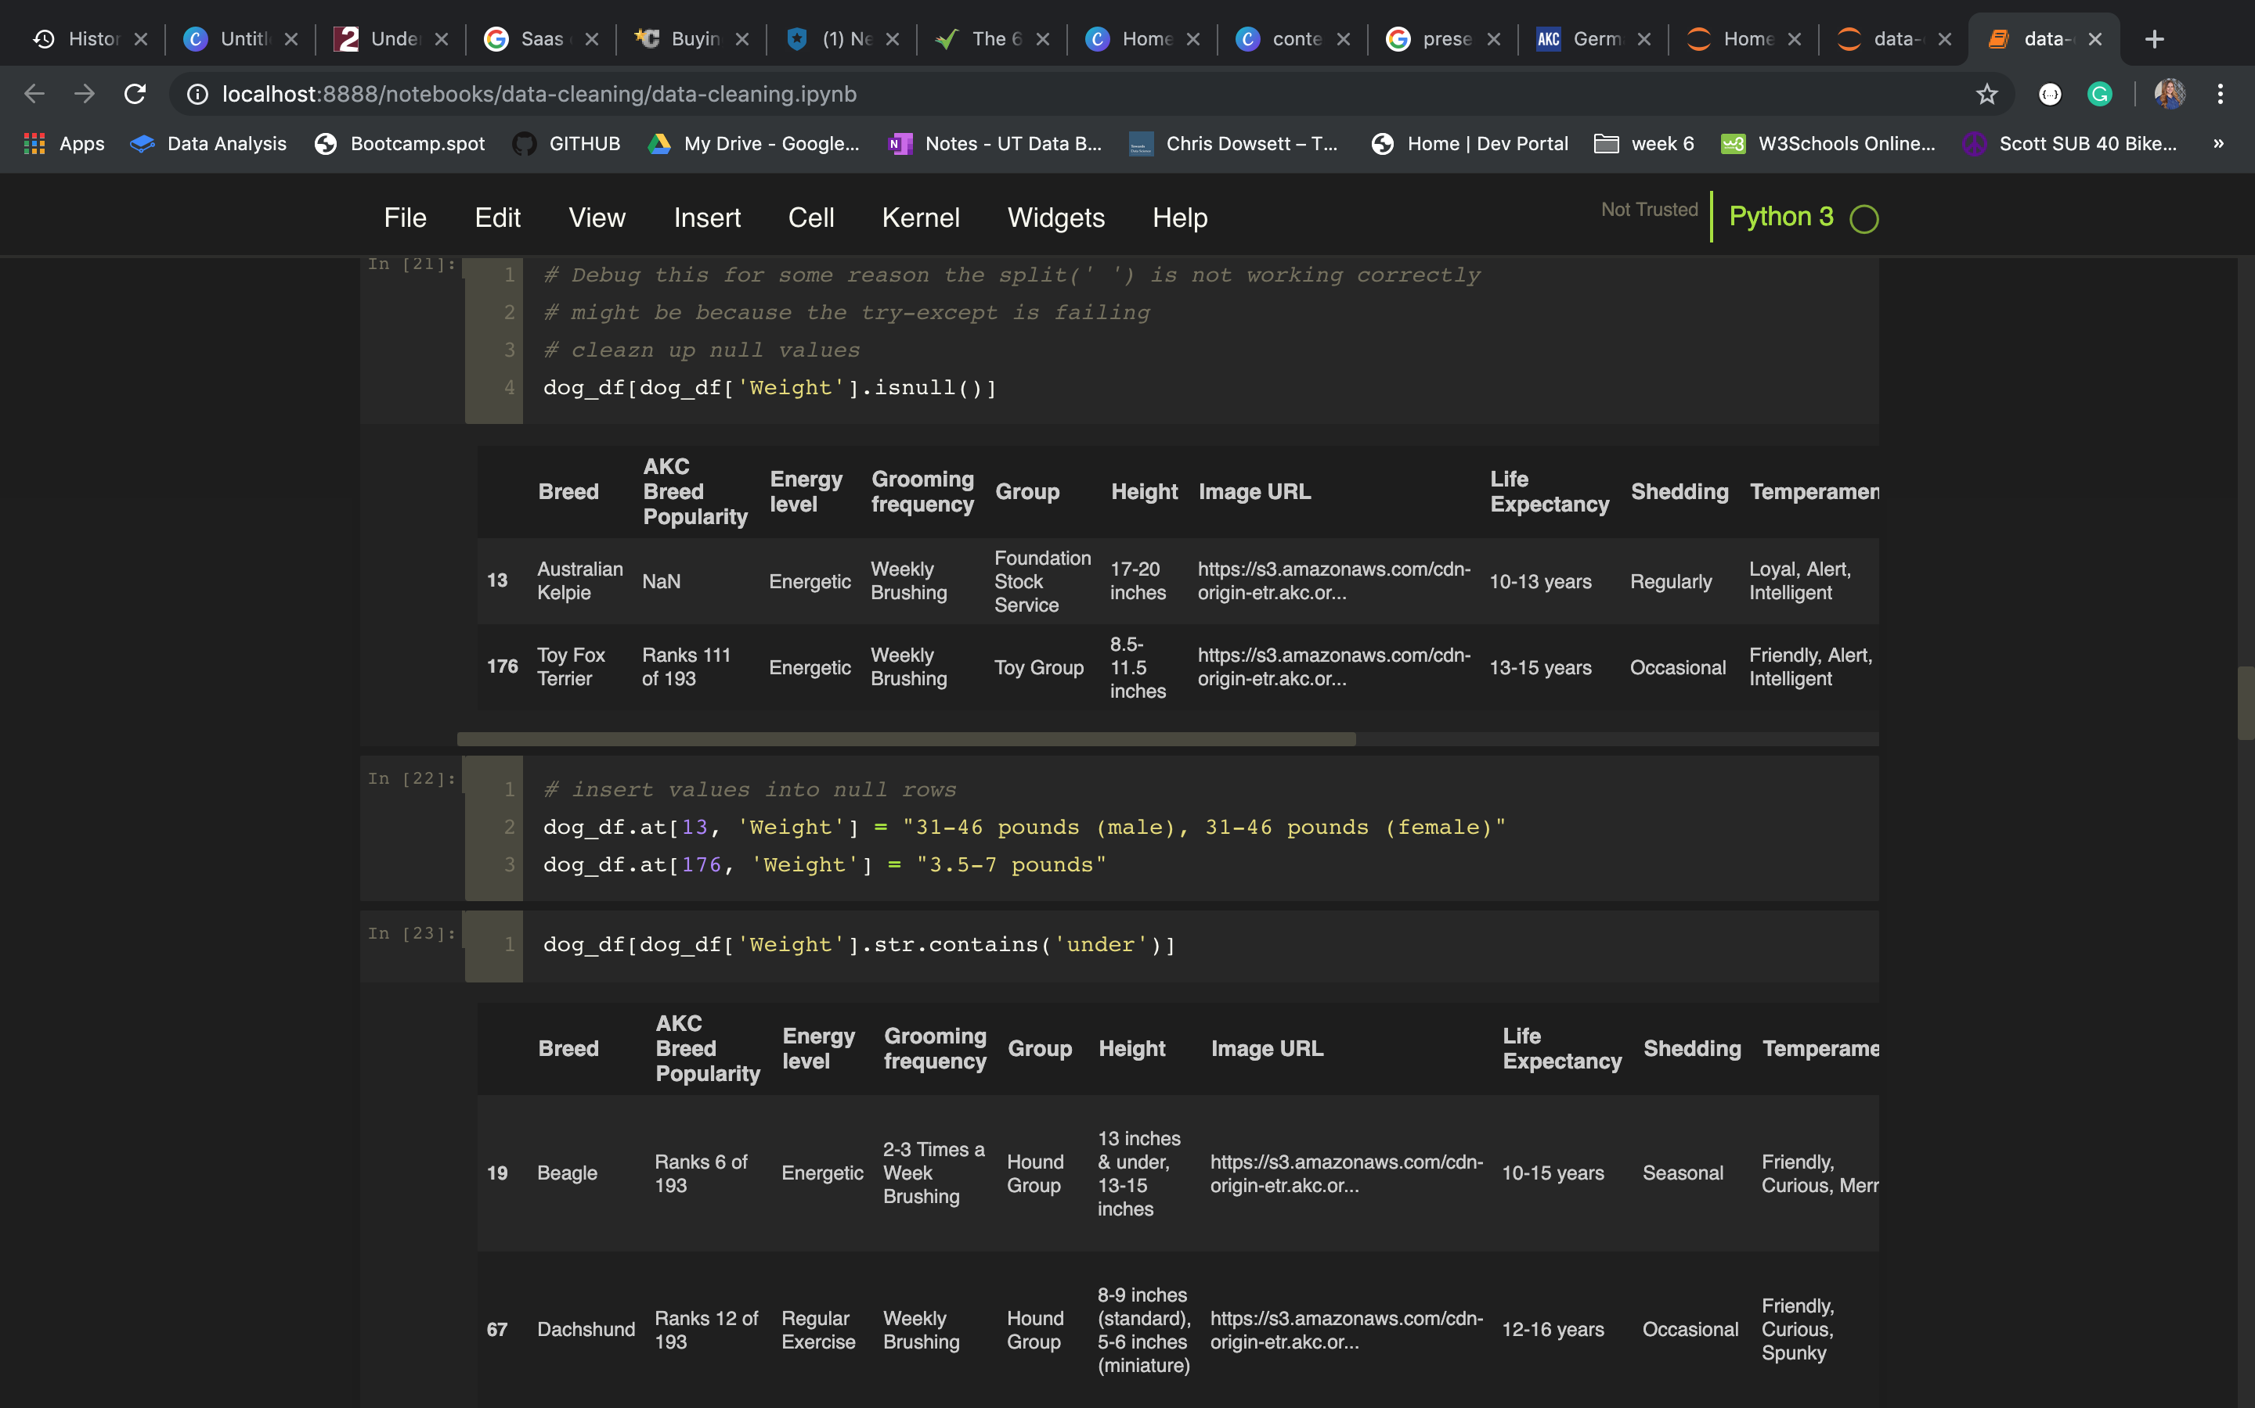
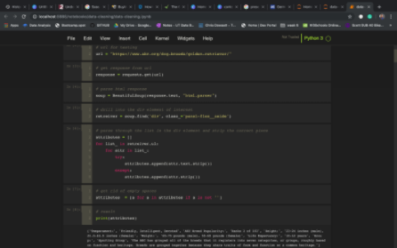
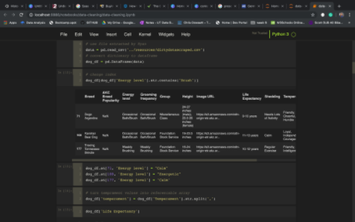
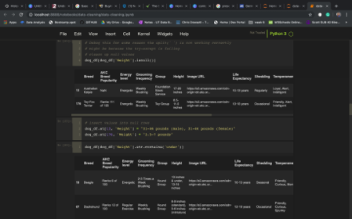
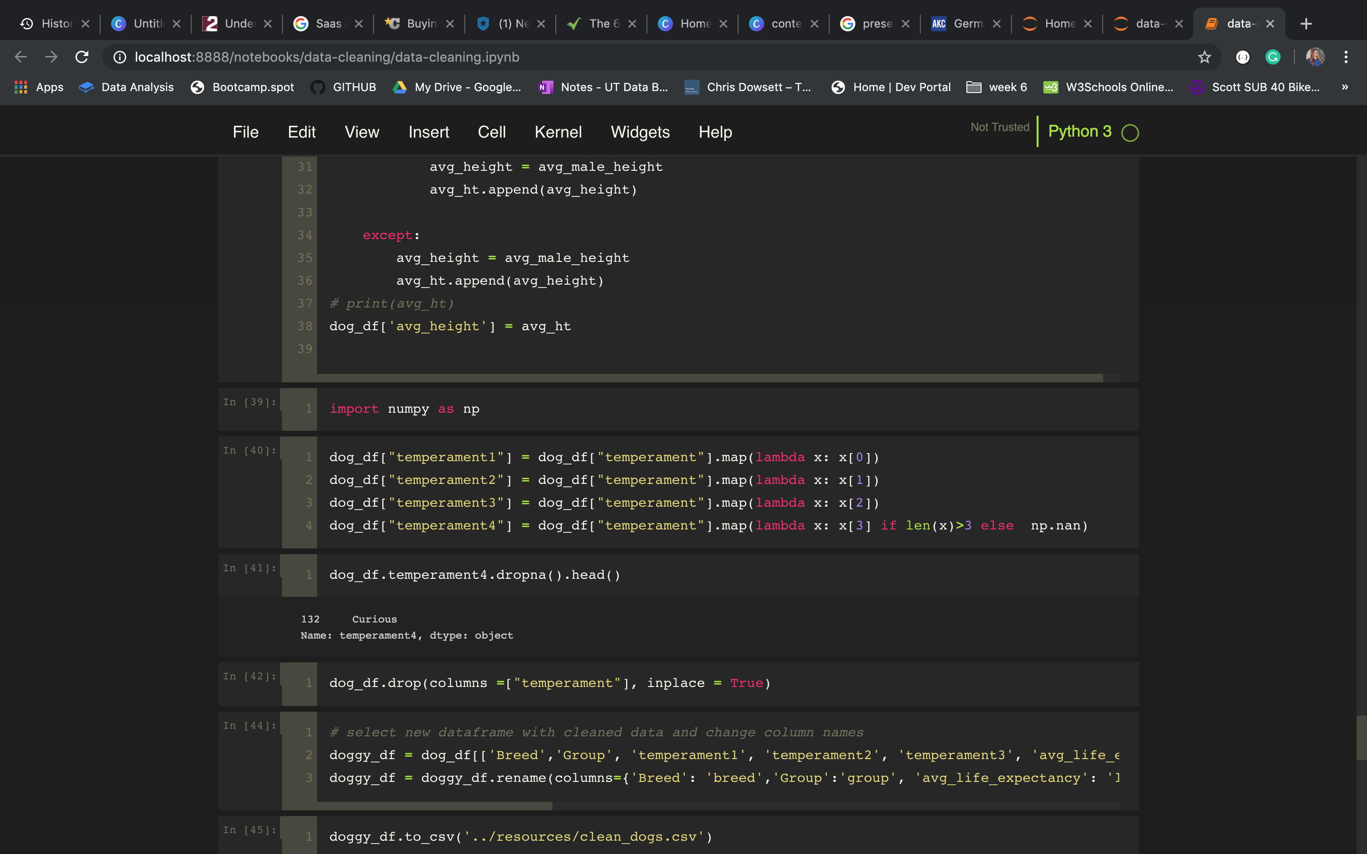
data cleaning

Slide 7

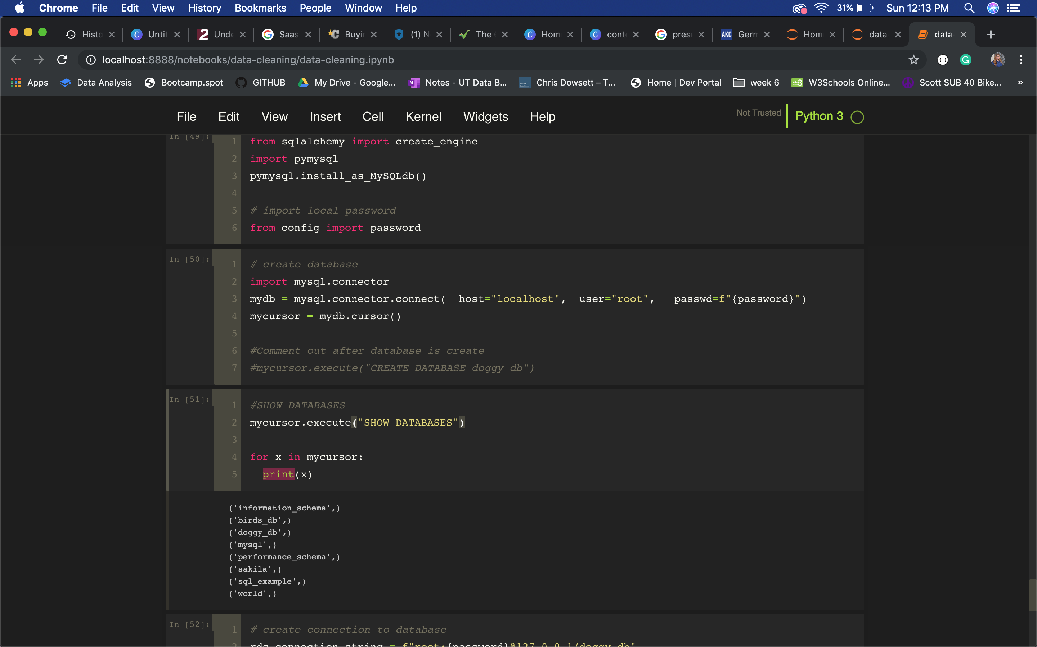
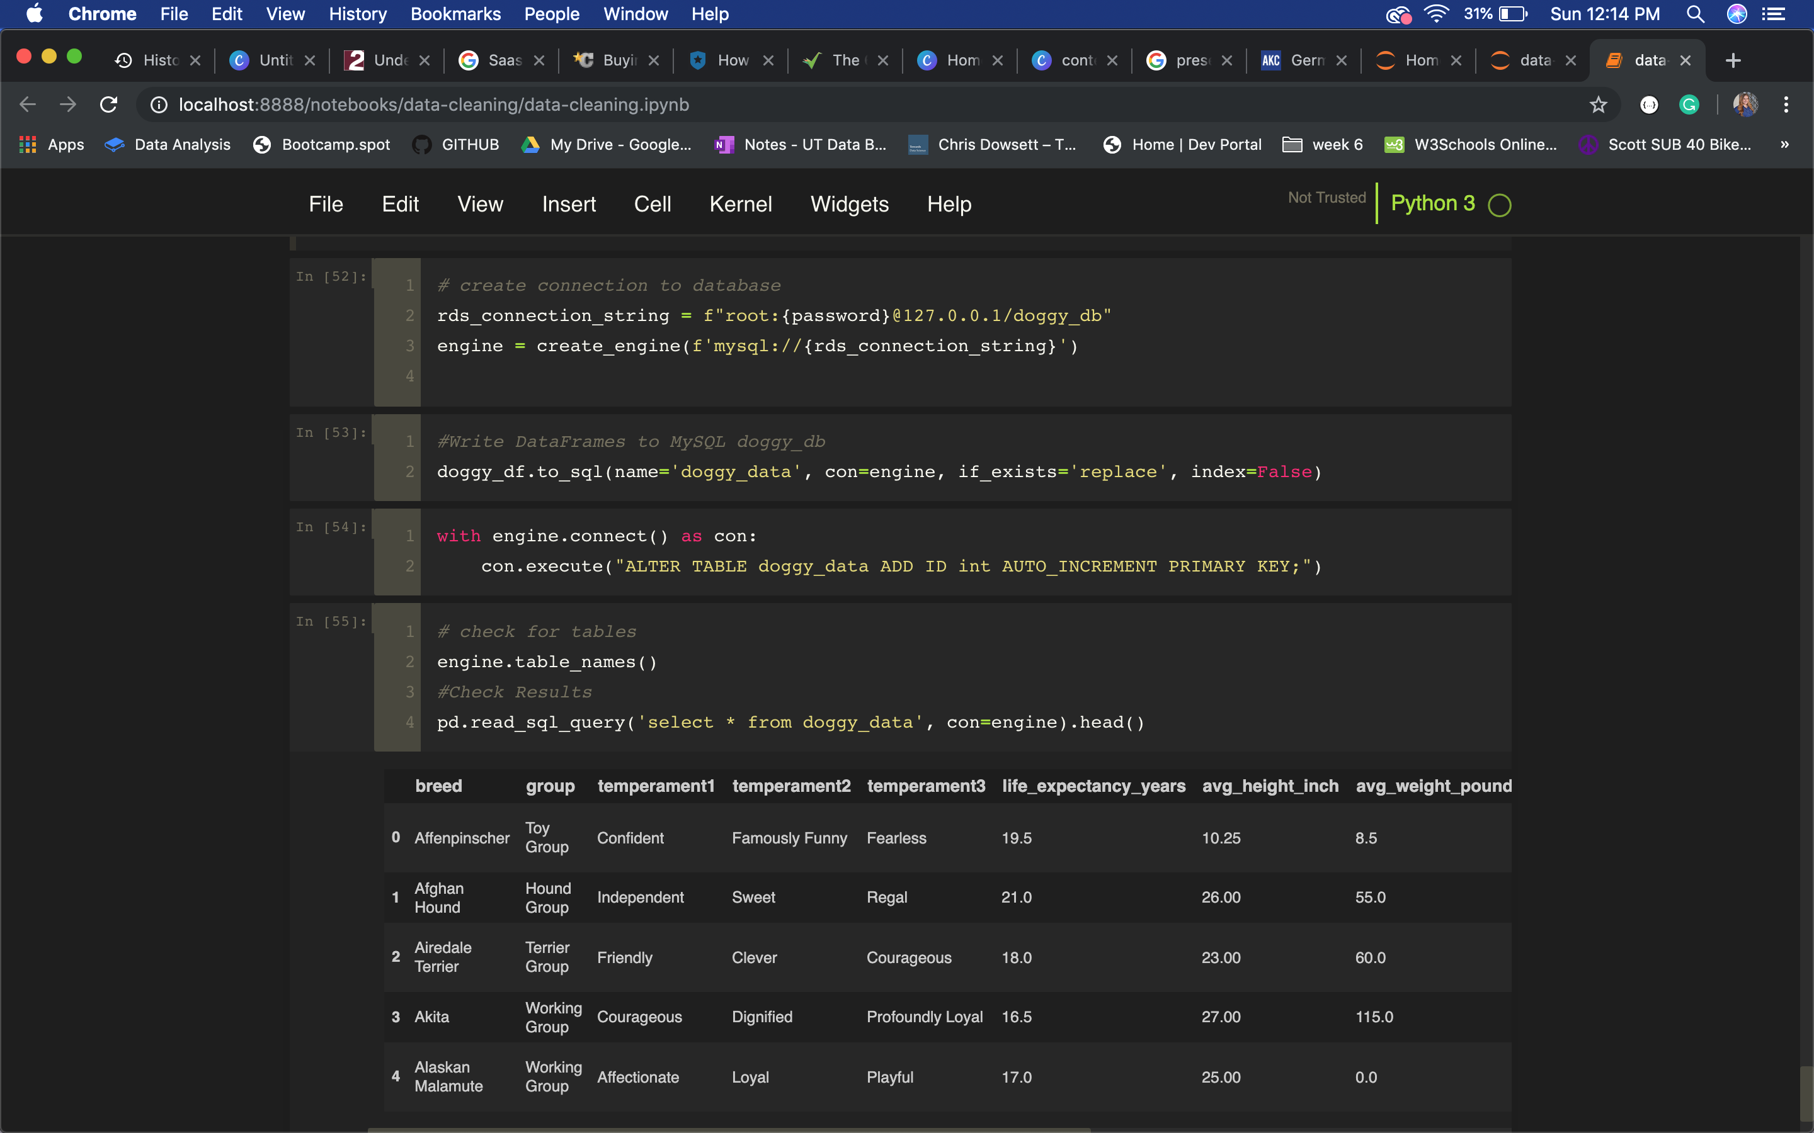
data storage

Slide 8
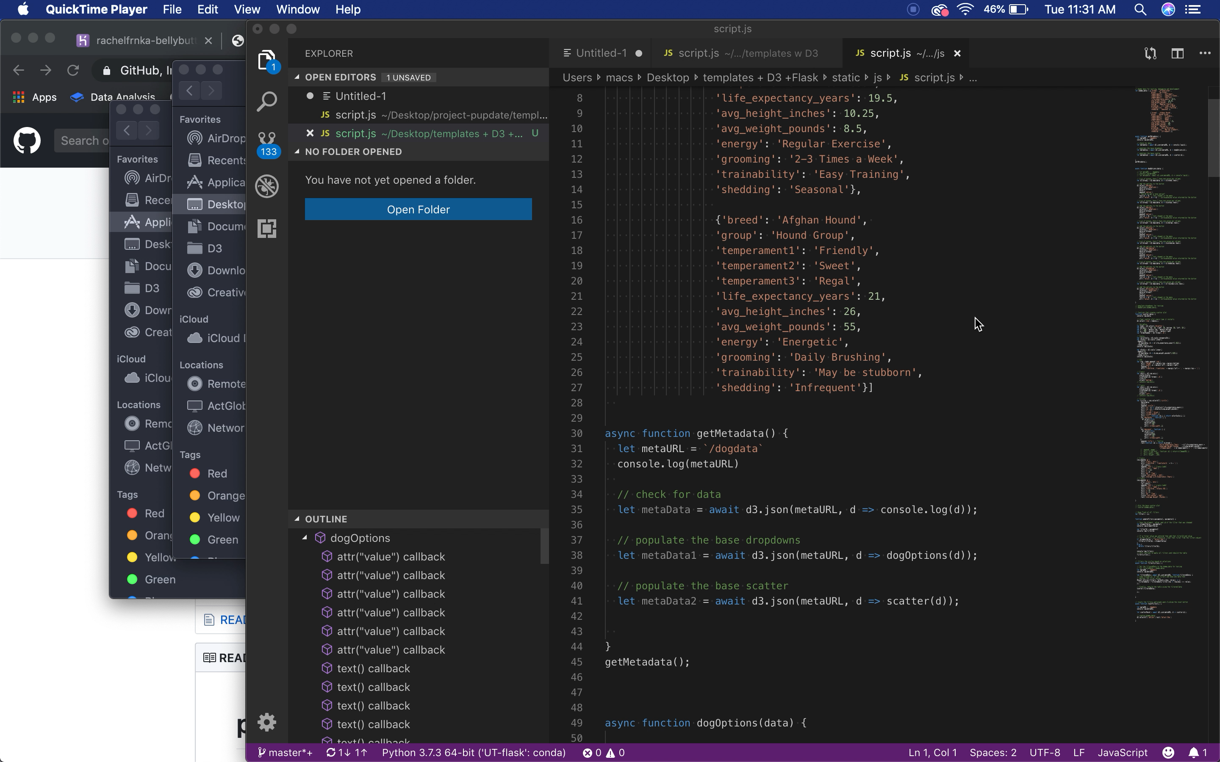
the scatter plot

Slide 9
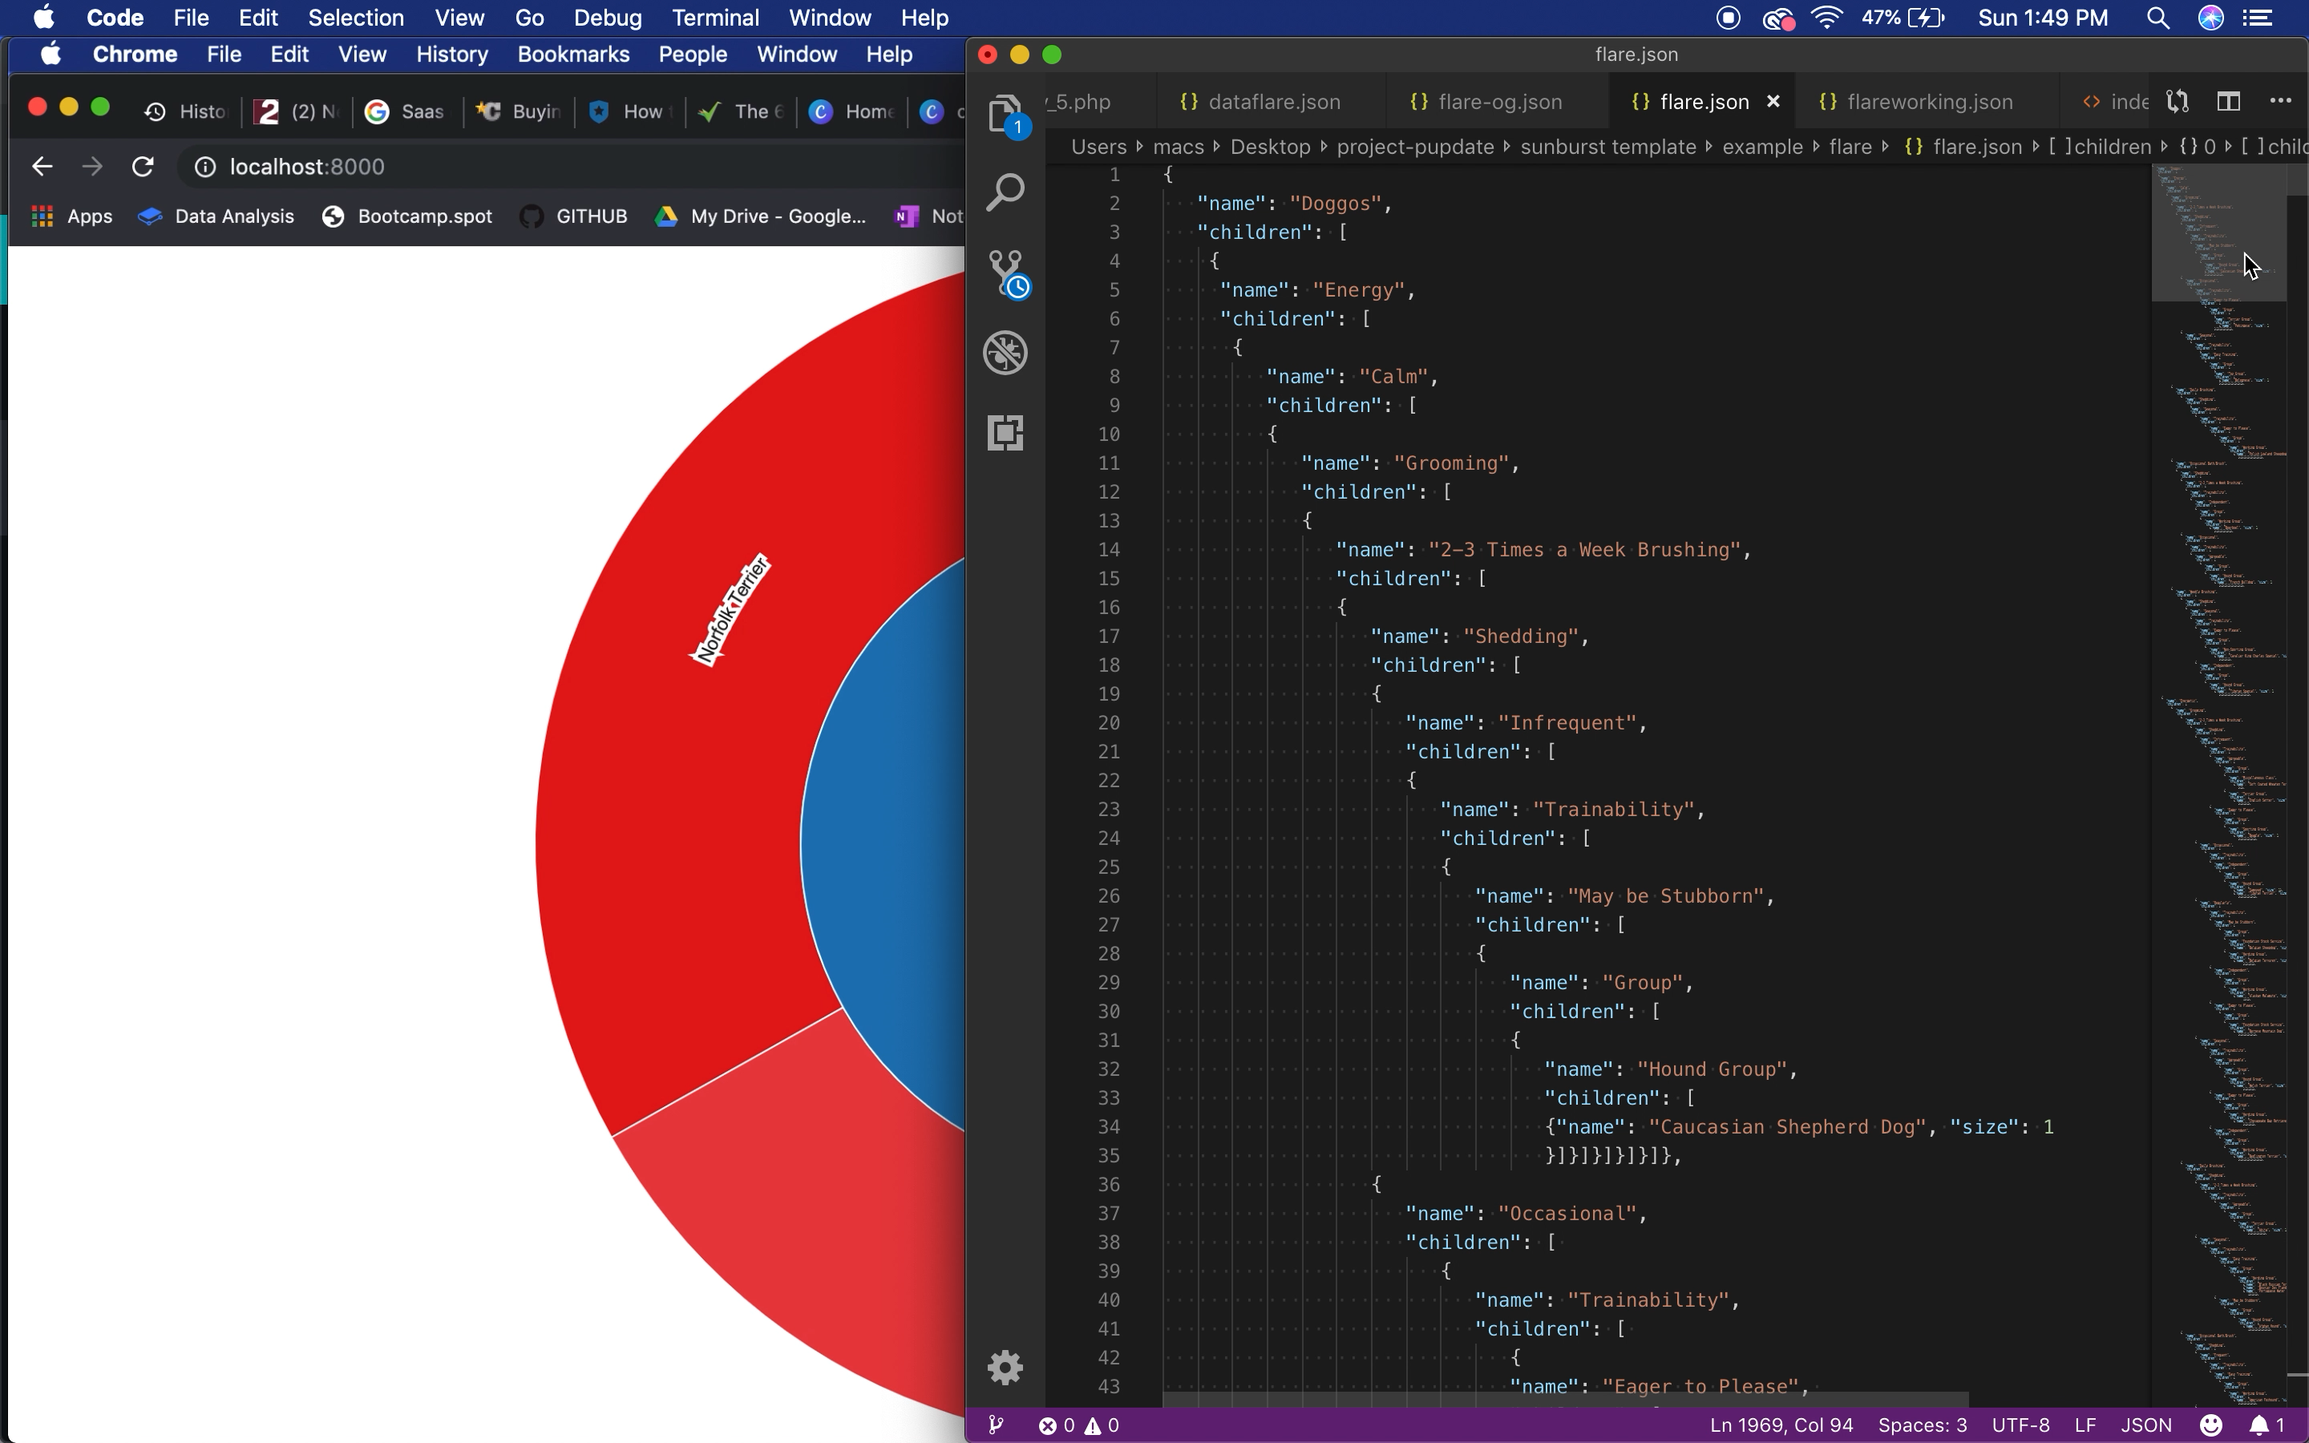
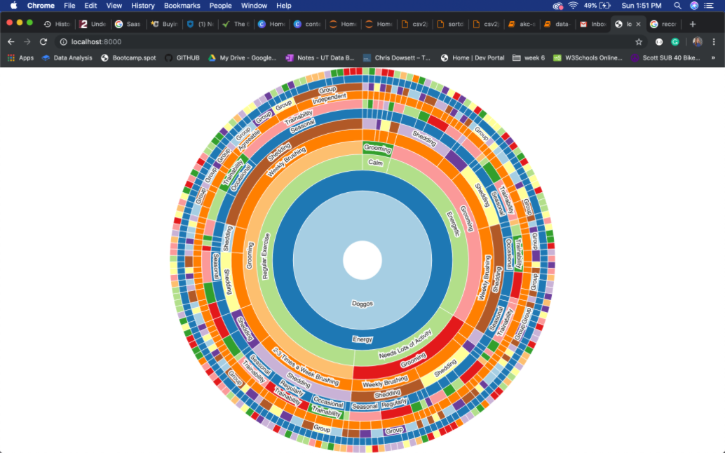
the sunburst

Slide 10

that's a wrap!

